Slide 1

GREEN SCAPE SOLUTIONS
Transforming spaces, one Lawn at a time

Slide 2
Table of content
1 | Our services
2 | Why choose us?
3 | What our customers say
4 | Customers review 2
5 | Customers review 3
6 | Let's transform your outdoor space

Slide 3

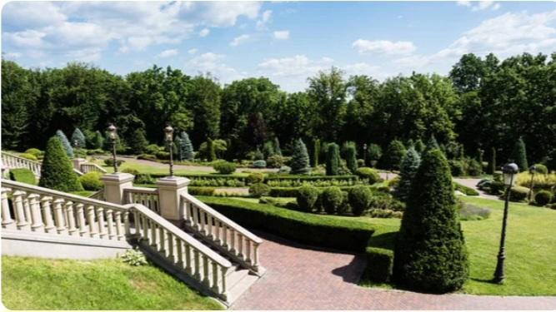


OUR SERVICES
Lawn care
Gardening
Landscaping
Seasonal maintenance
Customs Designs

Slide 4
Why choose us?
Eco-friendly Practices - Uses Organic fertilisers
Customer Satisfaction - 5-star service guarantee
Affordable Pricing - High quality at the best price
Experienced Team - Skilled professionals.

Slide 5

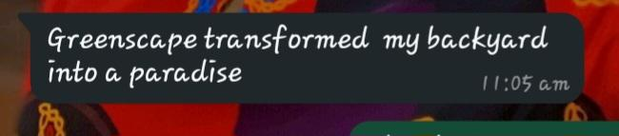
What our customers say!

Slide 6
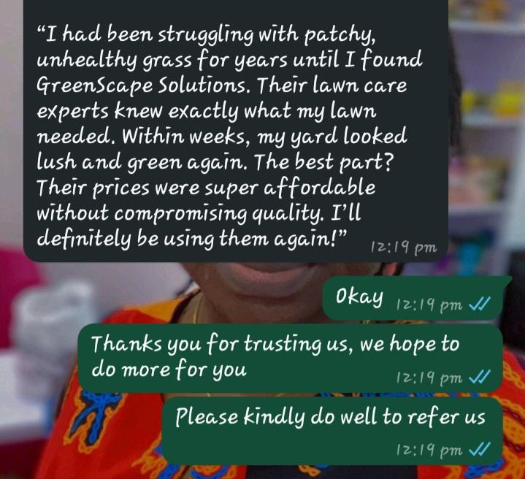

Customer review 2
Michael Thompson

Slide 7
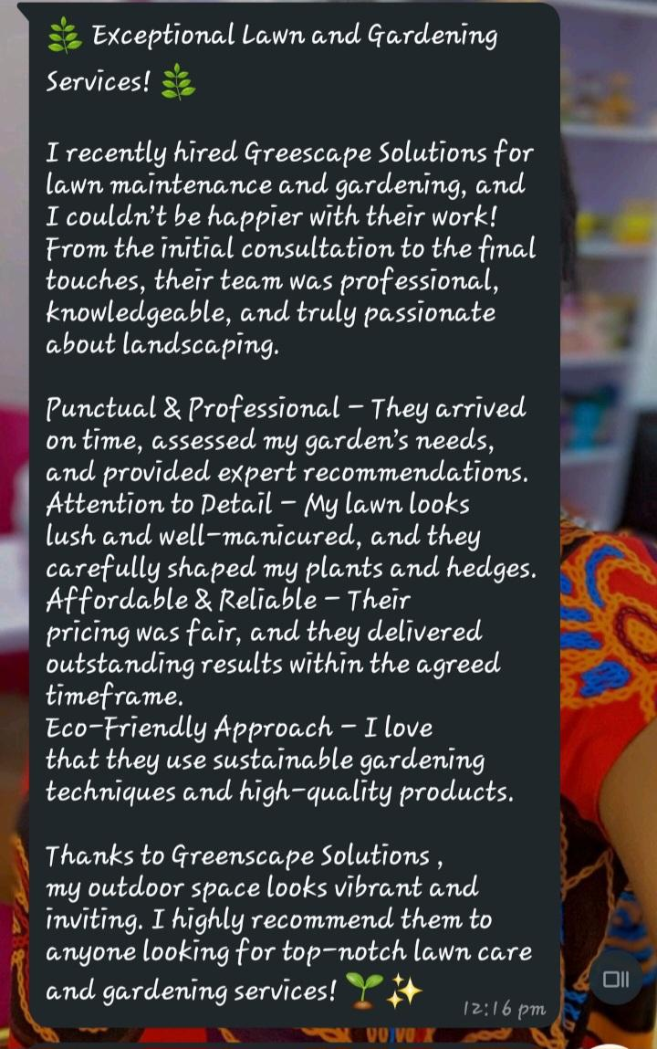
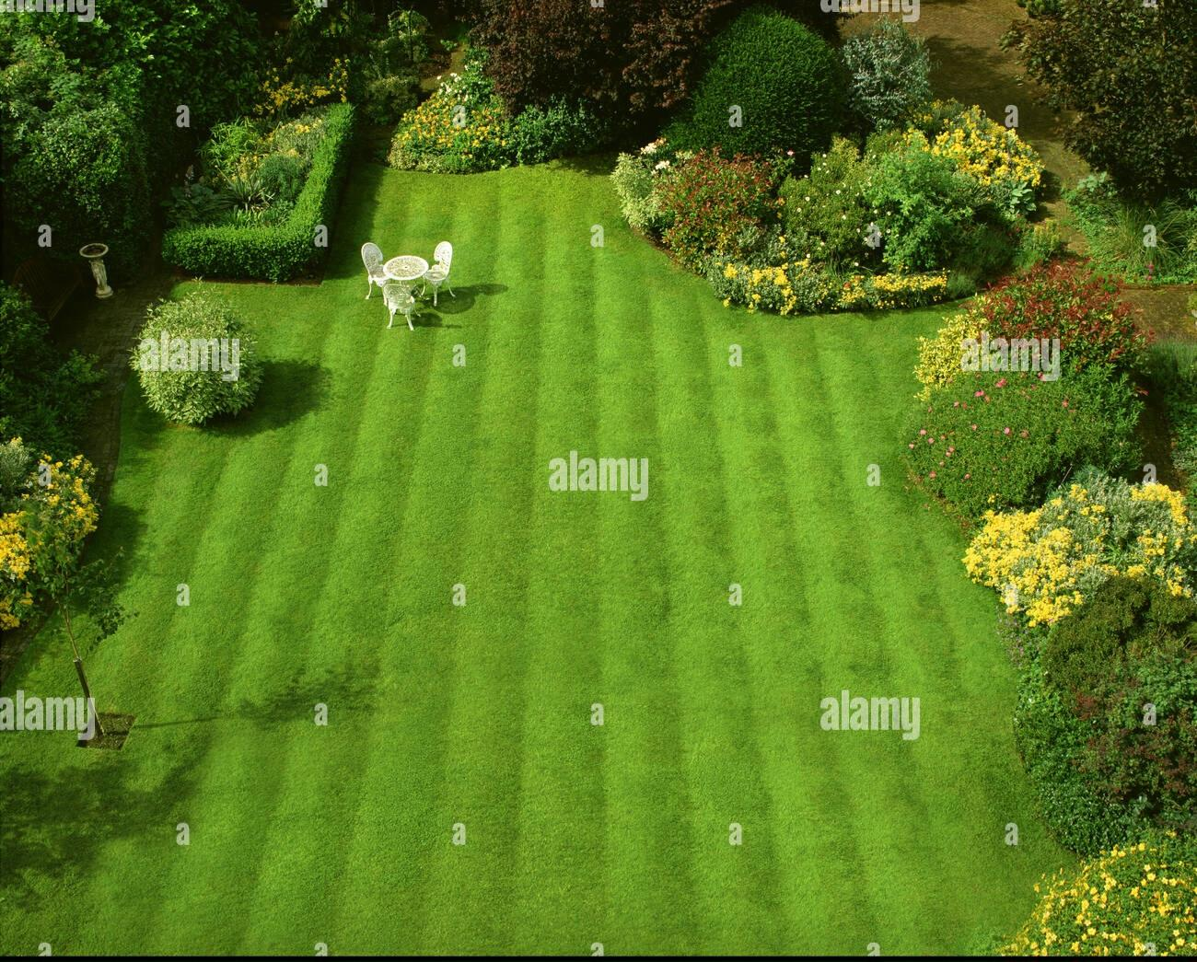
Customer review 3
Sarah Johnston

Slide 8

Lets transform your outdoor space!
Contact us today for free consultation
Phone Number: (+123) 8134806562
Enail: info@greenscapesolutions.com
Website: www.greenscapesolutions.com

